Slide 1

Policy Gradient for Continuing Tasks
Notes:
1

Slide 2
Objectives
Describe the objective for policy gradient algorithms.
Describe the policy gradient theorem
Policy Gradient for Continuing Tasks
2
Notes:
2

Slide 3
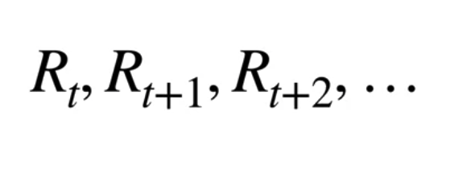
Objective for Learning Policies
What is the goal of Agent?
The goal of Reinforcement Learning is maximizing the reward in the long run.
Policy Gradient for Continuing Tasks
3
Notes:
3

Slide 4
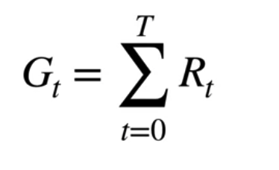
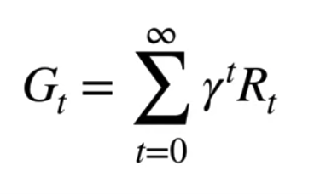
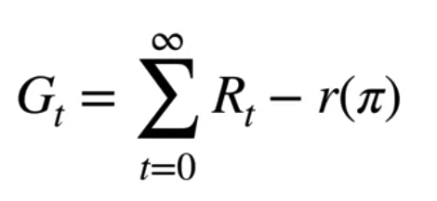
Objective for Learning Policies
Formalizing the gold as an Objective
Episodic: the sum of rewards over a whole episode
Continuing:
The discounted return
Sum of the differences between the immediate reward and its average
Policy Gradient for Continuing Tasks
4
Notes:
4

Slide 5
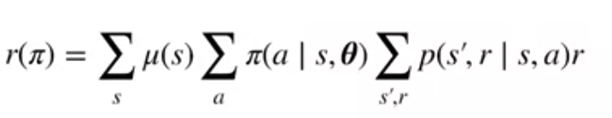
Objective for Learning Policies
The average reward objective
The overall average reward by considering the fraction of time we spend in state S under policy Pi.
The expected reward is a sum over S of the expected reward in a state weighted by Mu of S, r Pi is our average reward learning objective.
Policy Gradient for Continuing Tasks
5
Notes:
5

Slide 6
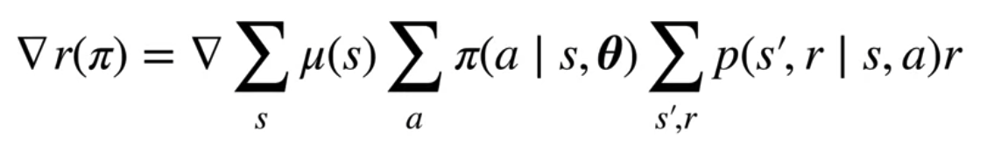
Objective for Learning Policies
Optimizing the average reward objective
Our goal of policy optimization will be to find a policy which maximizes the average reward.
Policy Gradient for Continuing Tasks
6
Notes:
6

Slide 7
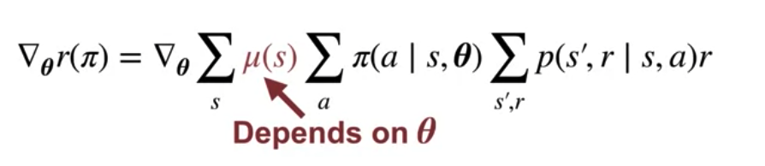
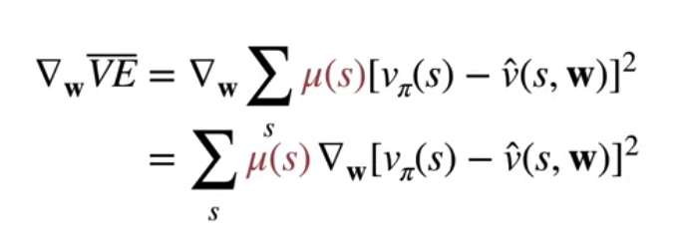
Objective for Learning Policies
The challenge of the policy gradient methods
The main difficulty is that modifying our policy changes the distribution Mu.
It does not change as the weights and the parameterized value function chains
Policy Gradient for Continuing Tasks
7
Notes:
7

Slide 8
Objective for Learning Policies
The objective of policy gradient algorithms:
It is to directly optimize the parameters of a parameterized policy in order to maximize the expected cumulative rewards obtained by an agent in an environment.
It aim to directly learn a policy that selects actions based on the observed states.
It compute an estimate of the gradient of the expected return with respect to the policy parameters.
Policy Gradient for Continuing Tasks
8
Notes:
8

Slide 9
The Policy Gradient Theorem
It provides a theoretical foundation for optimizing parameterized policies using gradient-based methods.
The theorem establishes a relationship between the expected return of a policy and the gradient of the policy parameters with respect to this expected return.
Policy Gradient for Continuing Tasks
9
Notes:
9

Slide 10
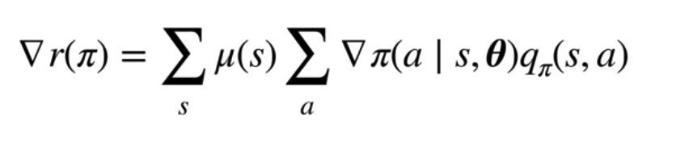
The Policy Gradient Theorem
The policy gradient theorem:
Policy Gradient for Continuing Tasks
10
Notes:
10

Slide 11
The Policy Gradient Theorem
The gradient of the policy parameters is estimated using samples obtained through interactions with the environment.
By directly optimizing the policy parameters along the direction of the gradient, these methods aim to improve the policy's performance and maximize the expected return over time.
Policy Gradient for Continuing Tasks
11
Notes:
11

Slide 12
Summary
Describe the objective for policy gradient algorithms.
Describe the policy gradient theorem
Policy Gradient for Continuing Tasks
12

Slide 13
Q & A
Policy Gradient for Continuing Tasks
13

